Slide 1

Live green & Live Happy
Anupam Banerjee
Dante Burch
Gwen Hickey
Robert Gastineau
Shravani Mandalaparty

Slide 2
Background Information& Problem Statement
Background Information
Analyze data on 1,002 individuals engaged in 27 activities of daily life
Interpret activities in context of their carbon footprint as a way to promote environmental sustainability
https://www.mindsumo.com/contests/campus-analytics-challenge-2018
Problem Statement
Recommend environmentally-friendly changes to everyday actions without lessening individuals’ quality of life

Slide 3
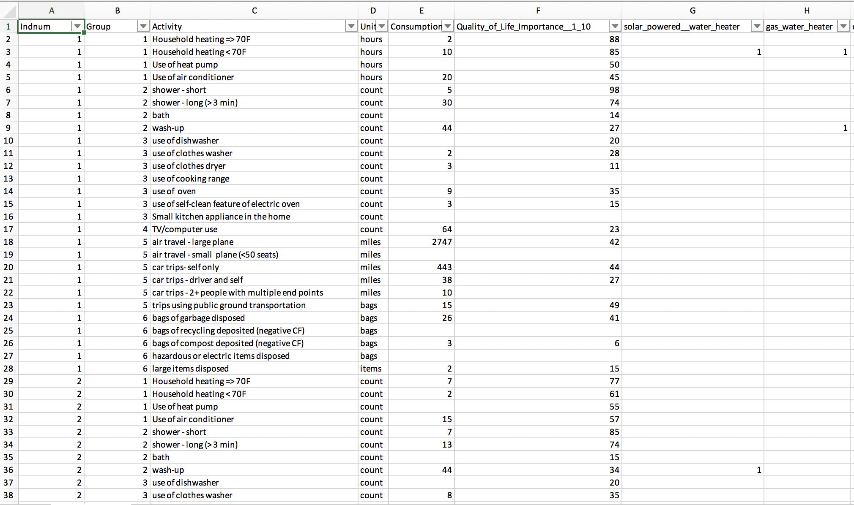
Data Set – Individuals
Data set consists of 1,002 individuals who provided the following information on 27 activities:
Consumption
QoL importance for each (1-100)
Energy Source Usage – Y / N

Slide 4
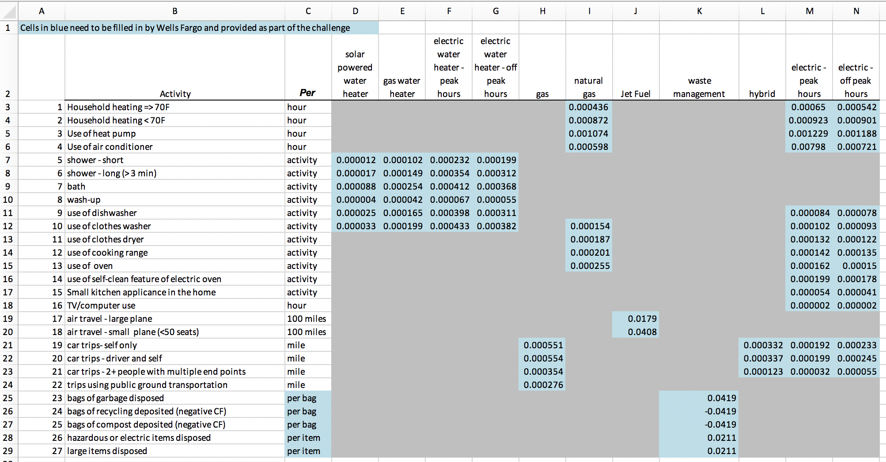
Data Set – Carbon Footprint
”Look-up” table for each of the 27 activities showing:
Carbon Footprint for an activity+ energy source combination

Slide 5
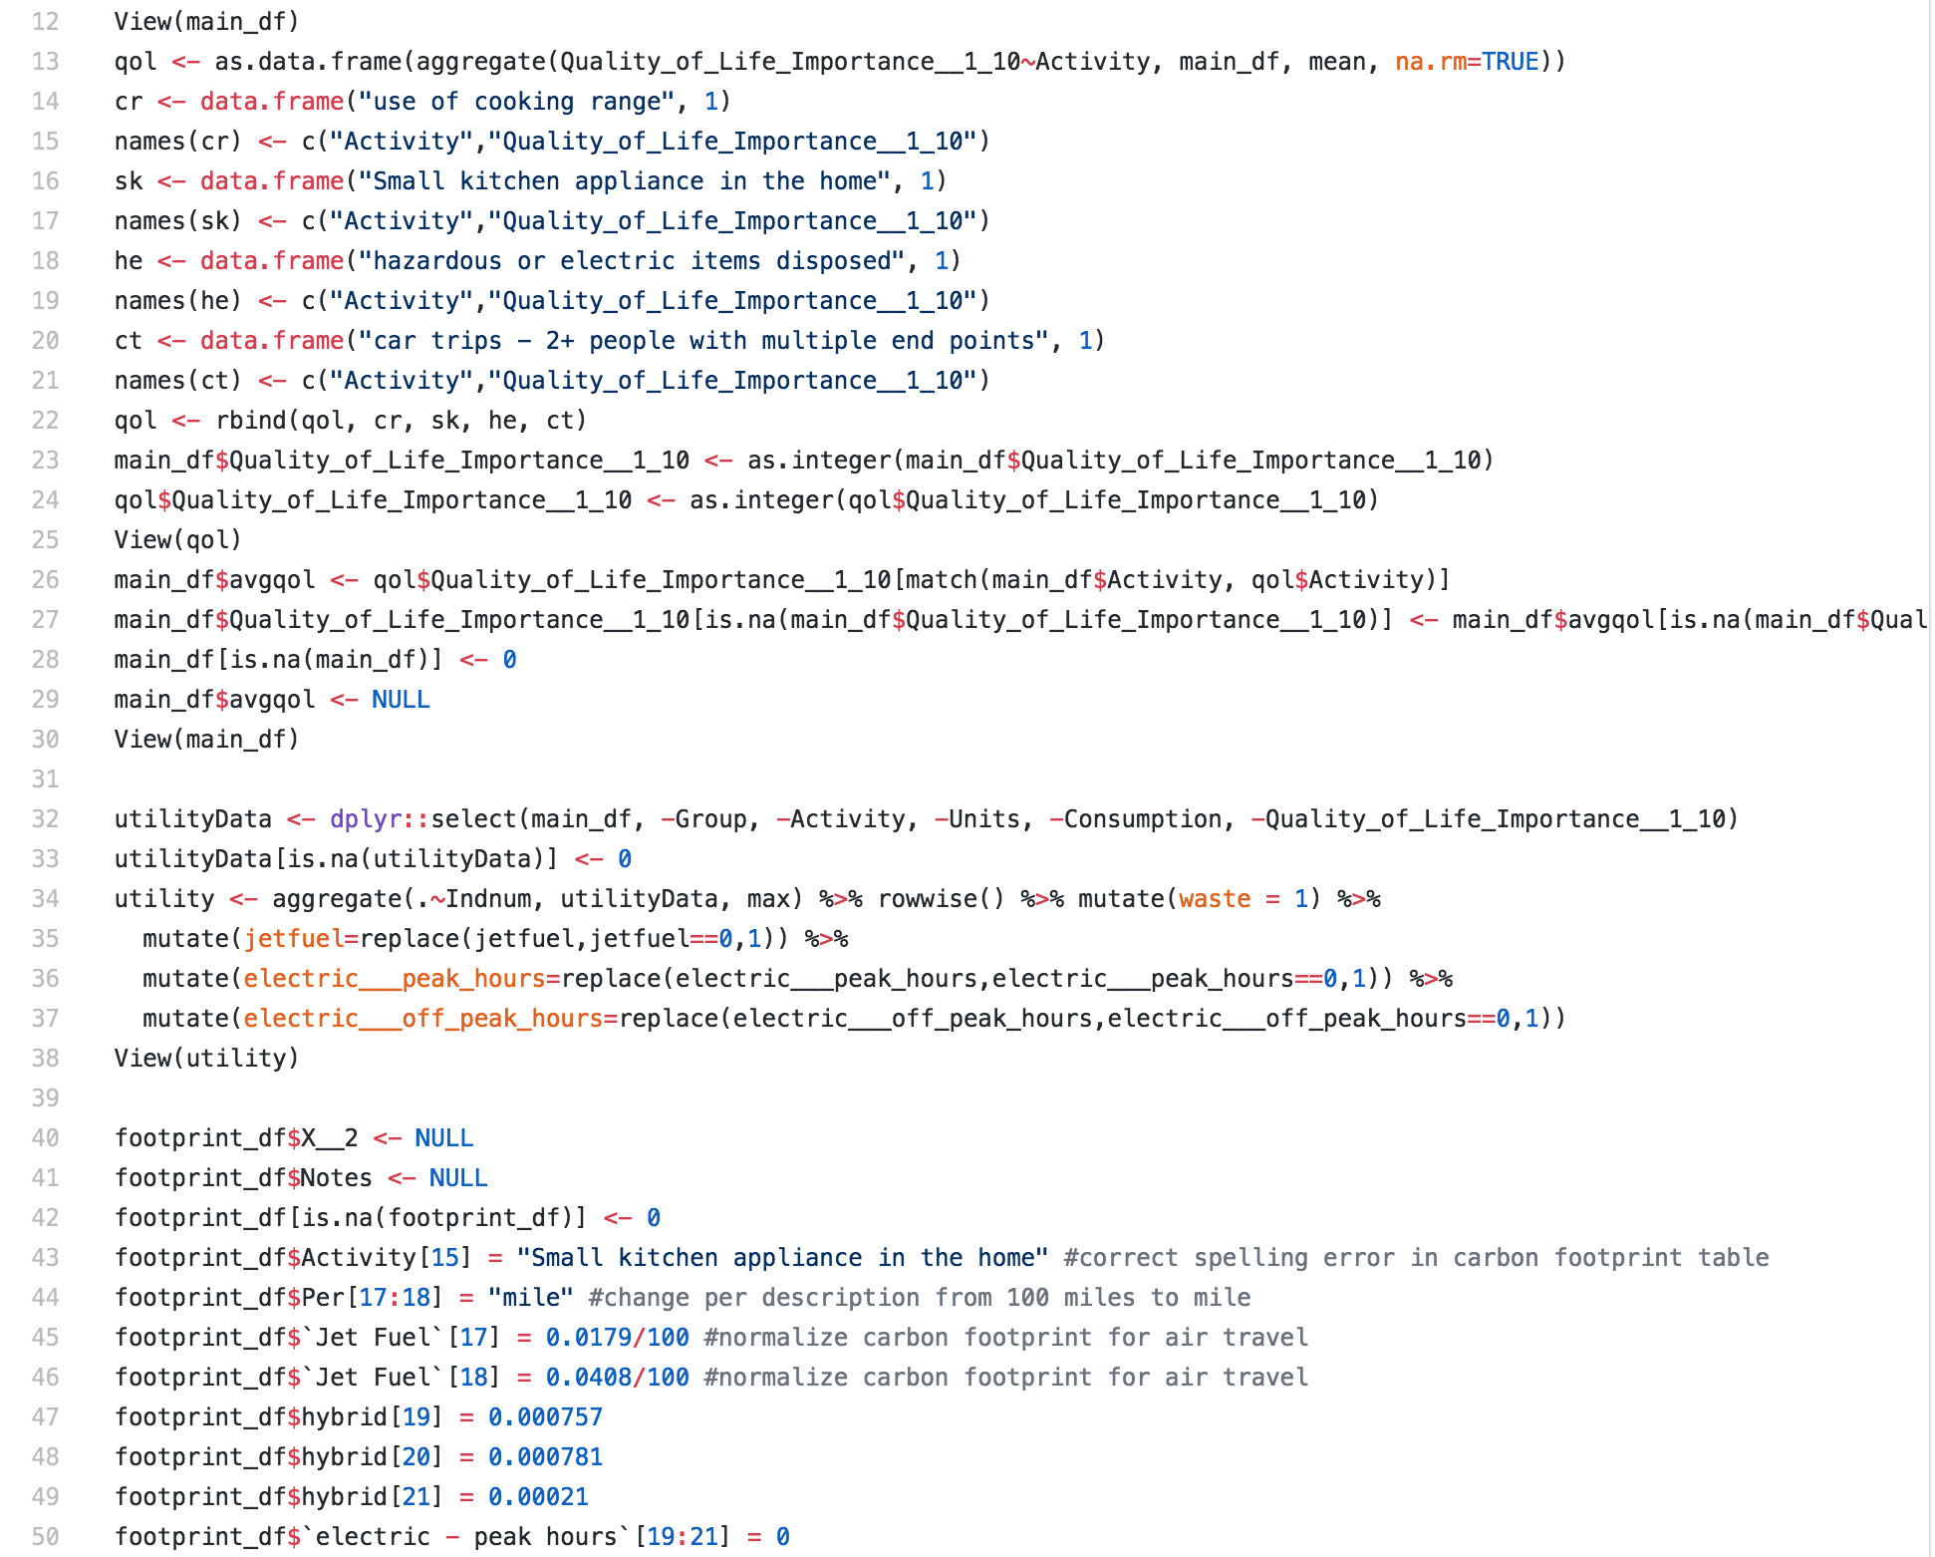
Data Wrangling using R

Slide 6
Data Wrangling Logic & Approach
Assume if a 1 exists for a particular activity, it should exist for all activities that use that energy source
Set energy source usage data to 1 & 0 across all individuals & activities
Calculate Total Carbon Footprint (TCF) for each record
(Consumption * Activity Indicator (y = 1 / n = 0) * CF)
Calculate Average Carbon Footprint (ACF) for each record
TCF / # of energy sources for that activity
For blank values of Consumption, assume the Carbon Footprint is 0
For blank values of quality of life importance, populate it with the mean value – across all individuals – for the given activity

Slide 7
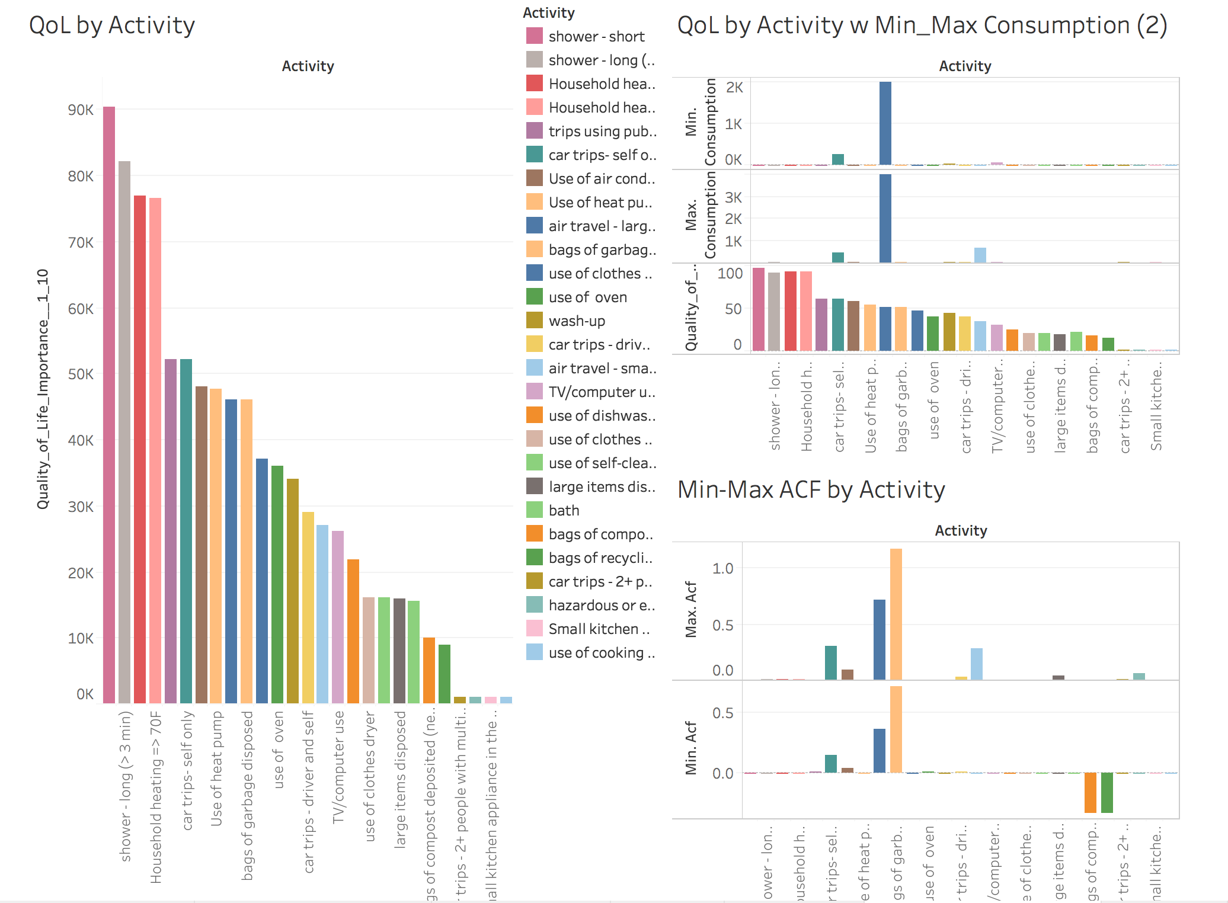
Whole Group before Optimization: QoL, Consumption & ACF byActivity

Slide 8
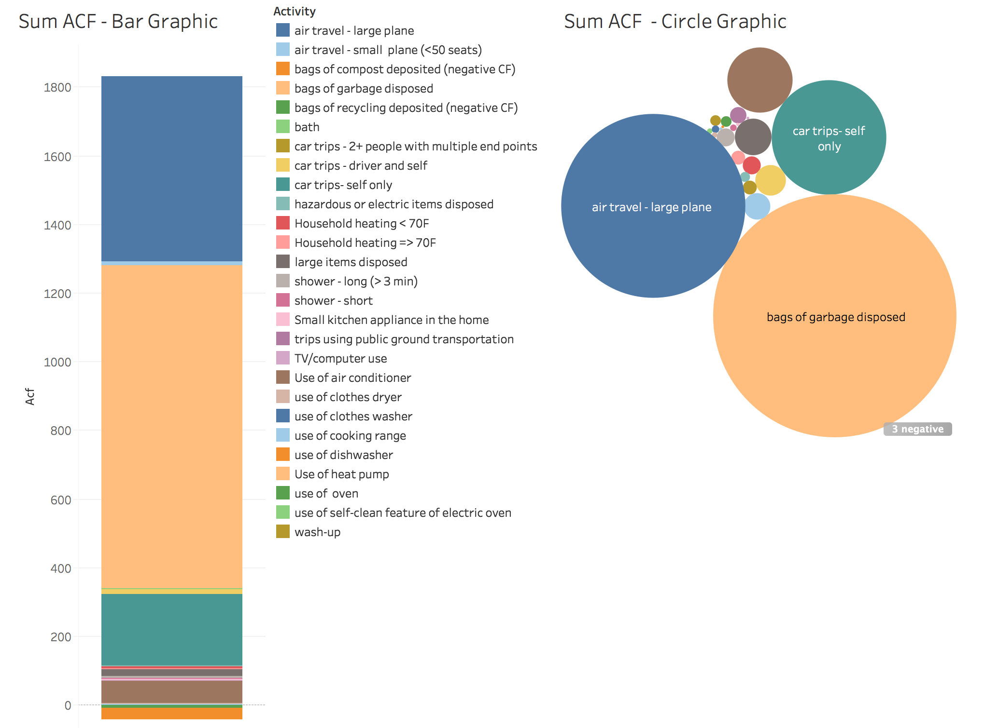
Whole Group before Optimization: ACF by Activity

Slide 9
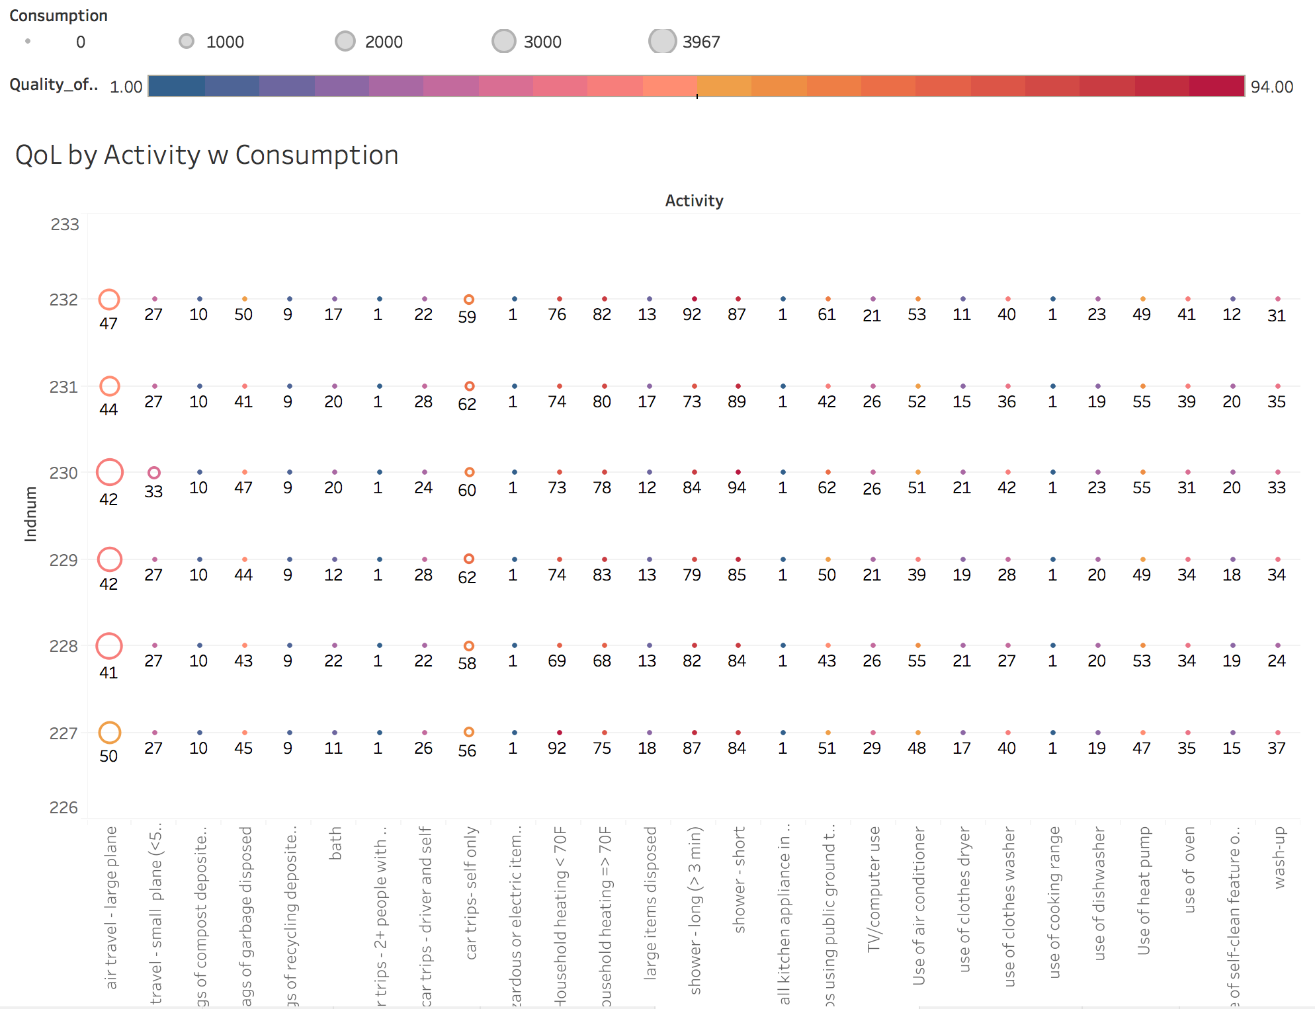
5 Individuals before Optimization: QoL & Consumption by Activity

Slide 10
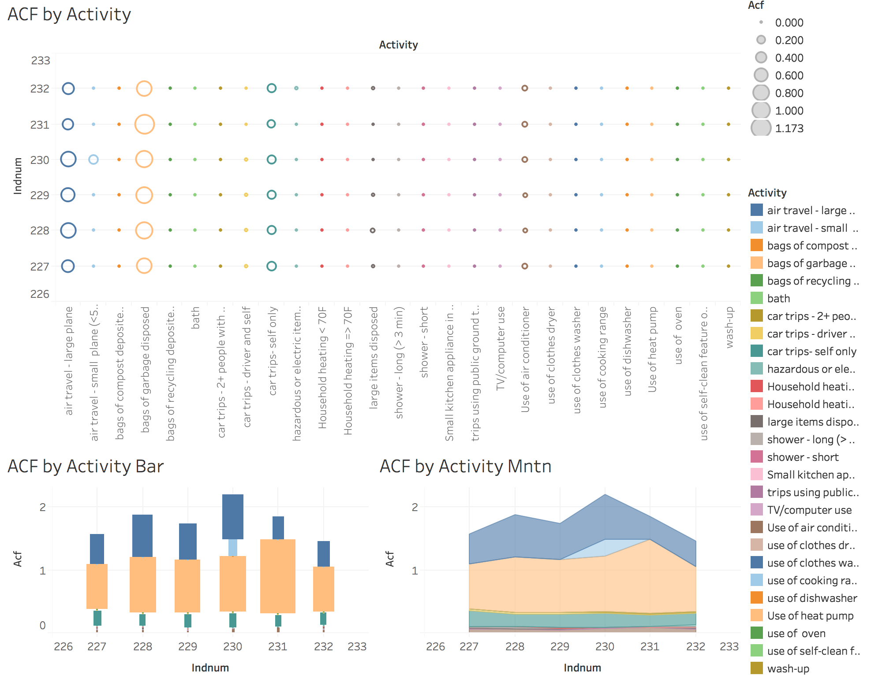
5 Individuals before Optimization: ACF by Activity

Slide 11
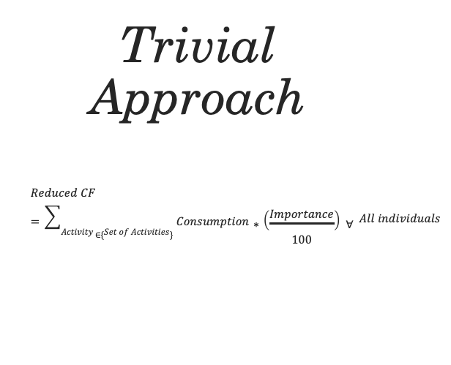
Trivial Approach $$Reduced CF=\sum_{Activity ∈\{Set of Activities\}}{Consumption∗\left(\frac{Importance}{100}\right) ∀} All individuals$$

Slide 12
Constraints & Optimization Logic

Slide 13
Optimization using R

Slide 14
Whole Group after Optimization: QoL, Consumption & ACF byActivity

Slide 15
Whole Group after Optimization: ACF by Activity

Slide 16
5 Individuals after Optimization: QoL & Consumption by Activity

Slide 17
5 Individuals after Optimization: ACF by Activity

Slide 18
Whole Group Before / After View

Slide 19
5 Individuals Before / After View

Slide 20
Work in progress
Preference Analysis using Ranking methods.
Example:
Friedman rank sum test
data: sample_heat
Friedman chi-squared = 242.18, df = 3, p-value < 2.2e-16
Exploring nonlinear machine learning optimization techniques like Nelder and Mead, quasi-Newton method, and conjugate gradients method .

Slide 21
Results Summary

Slide 22
Insights & Lessons Learned

Slide 23
Tools & Works Cited
R Studio
Tableau
Campus Analytics Challenge: Live Green and Live Happy, www.mindsumo.com/contests/campus-analytics-challenge-2018. Accessed 30 Nov. 2018.

Slide 24
Questions?

